Slide 1

Effective software development process Oleksandr Krakovetskyi CEO, DevRain Solutions @msugvnua, alex.krakovetskiy@devrain.com

Slide 2
About
CEO of DevRain Solutions – software development (specialization: Windows Phone and Windows 8).
Microsoft Regional Director.
Microsoft Windows Phone Most Valuable Professional.
Telerik Most Valuable Professional.
Best Professional in Software Architecture (Ukrainian IT Award).
Ph.D.
Speaker and IT blogger.

Slide 3
What makes you unique
Deep expertise and rich portfolio.
Avoiding common mistakes.
Good management and development process.
Using best tools.

Slide 4
~80% of projects are not successful * project considered successful if budget and schedule exceed not more than 20% compared from the planned ones

Slide 5
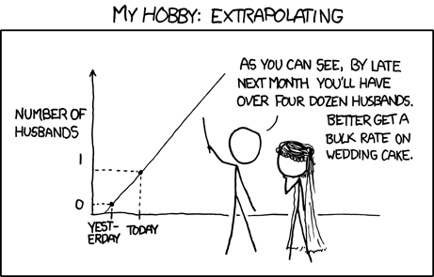
Development is non-linear process
Increasing number of team members == increasing of communication complexity.
Development is not about time and resources, it is about people and services.
Productivity of junior/middle developer and “guru” may differ up to 5-10 times.

Slide 6
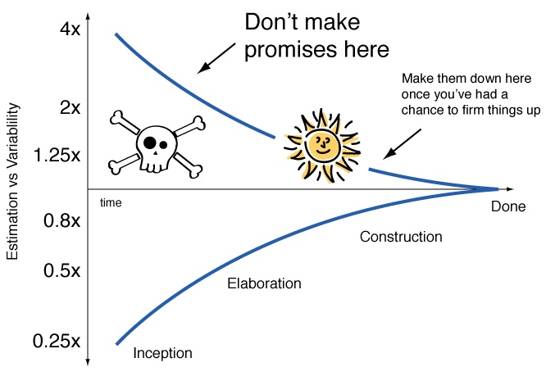
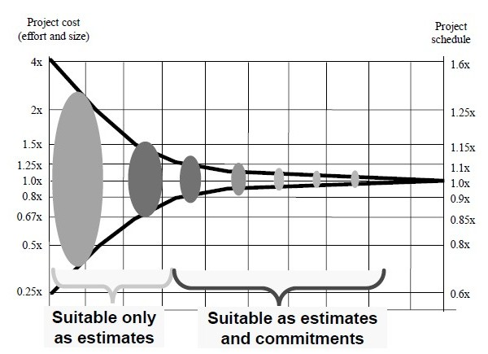
Error cost (cone of uncertainty)
At the beginning of any project we don’t know exactly how long a project is going to take.
No two ever projects have:
The same requirements.
The same people.
The same business context.
The same technology.
The same priorities & constraints.

Slide 7
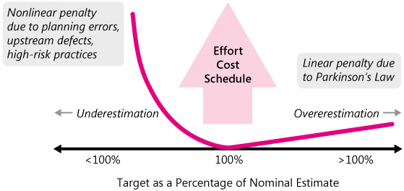
Parkinson's Law
Parkinson's Law states that work expands to fill the time available for it. Result? Extra time gained is wasted.

Slide 8
Zone of improbability
9 women can’t make a baby in a month
*25% - max volume of project squeezing time
Fred Brooks “Mythical man month”, 1975

Slide 9
“Zero” stage
Estimation, environment installation (staging and production), creating accounts for all team members, understanding roles and management flow
*it’s good to have “zero” stage completed as soon as possible

Slide 10
Simple estimation model
Hourly rate * hours * 1.3 = project cost
~30% - project risks (employees search, bug fixing, requirements missing, illness, lacks of communication, lazy developers)
Payable hour != standard hour

Slide 11

Two estimations (best/worse cases)
(Cbc * Pbc) + (Cwc * Pwc)
Cbc – cost (best case)
Pbc – probability (best case)
Cwc – cost (worse case)
Pwc – probability (worse case)
Real cost will be higher than best/worse average cost.

Slide 12
Quick estimation for mobile apps
iOS (iPhone + iPad)
Windows Phone + Windows 8
Android + tablets
Assume Windows Phone = 1 unit
1 (WP) + 0.75 (Win8) + 1.5 (iPhone) + 0.5 (iPad) + 2 (Android) = 5.75 (units)

Slide 13
Different goals
Customers are worried about business
Developers are worried about technologies and ideal code

Slide 14
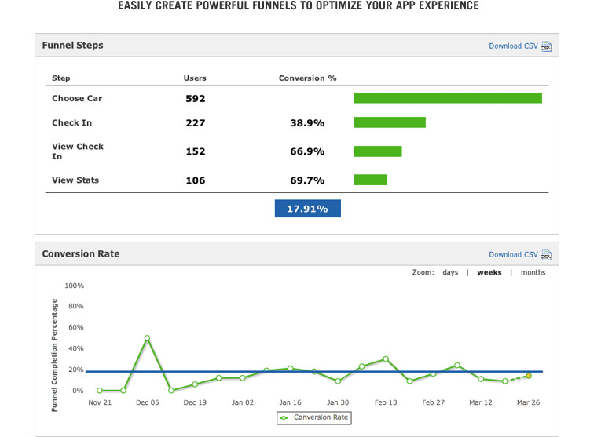
Funnels (measure user conversion rates)
Give your customer such answers:
how many users logged in?
how number of logins changed after implementing a new design?
how many users navigated from page 1 to page 2?
how many users clicked such button?
etc.

Slide 15
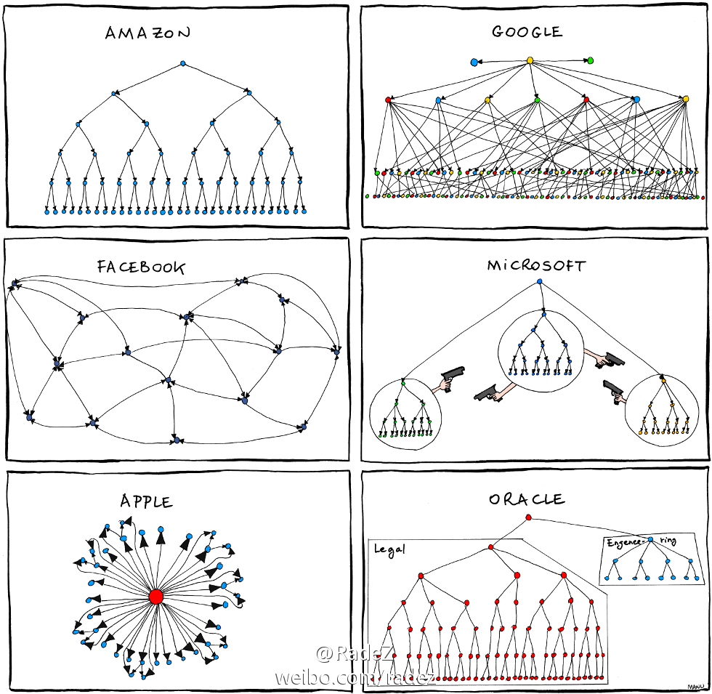
Communication
Ask yourself do you know:
who determines the business strategy of the project?
who will evaluate the quality of your work and what is “project done” criteria?
how many bosses do you have?
who has the final voice in decisions?

Slide 16
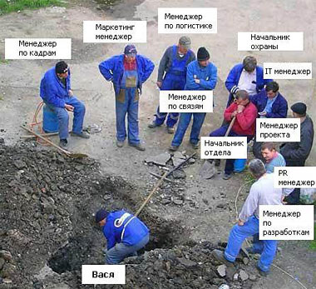
Roles not titles
Job title == many roles
Every team member should know his roles.
Avoid too many “bosses” (ideally just one).

Slide 17
Process highlights
With integration to customer’s process Team should be totally aware with customer’s business process.
Without integration to customer’s process Teams use own process internally and use a “public interface” to customer’s business process. Interfaces can be differ with different customers.
Orientation on result, not the process Agile is not good in all 146% cases. Sometimes F*ckup Development works better.

Slide 18
Process highlights
UX/UI & guidelines & graphic design Exactly in this order
If development for several platforms Make at least alpha version for the one platform with real data, than – other platforms
Time to first solution (estimate/answer) is very critical
Avoid “not invented here” philosophy Don’t hesitate to use already existing products, research, standards, or knowledge even if they are paid.
Use best tools Collaboration & communication, storage, documents exchange, source controls, tasks management, Wiki & CRM, feedback etc.

Slide 19
What tools we use
UX/UI, collaboration, communication, source control, docs management, education

Slide 20
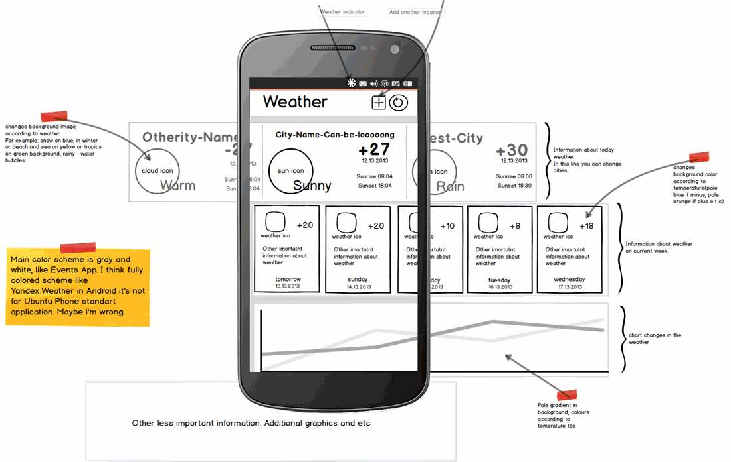
UX/UI & Prototyping
SketchFlow:
Windows Phone, XAML apps;
MockupBuilder, Balsamiq:
sketchy wireframes;
UI components & icons;
drag & drop simplicity;
click-through prototypes.

Slide 21
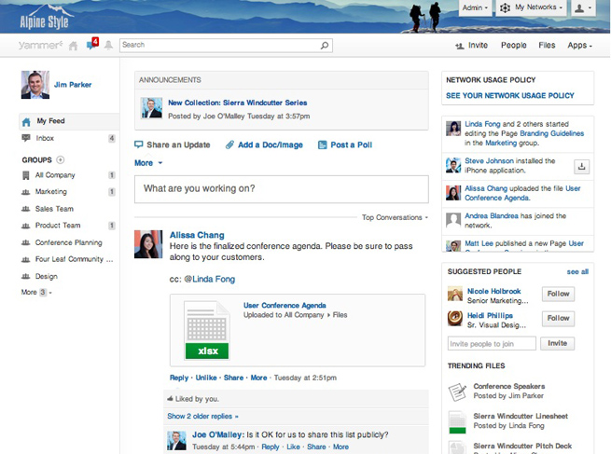
Collaboration
Yammer:
Freemium enterprise social network service that was launched in 2008 and sold to Microsoft in 2012.
Yammer is used for private communication within organizations and is an example of enterprise social software.
Access to a Yammer network is determined by a user's Internet domain so that only individuals with appropriate email addresses may join their respective networks.

Slide 22
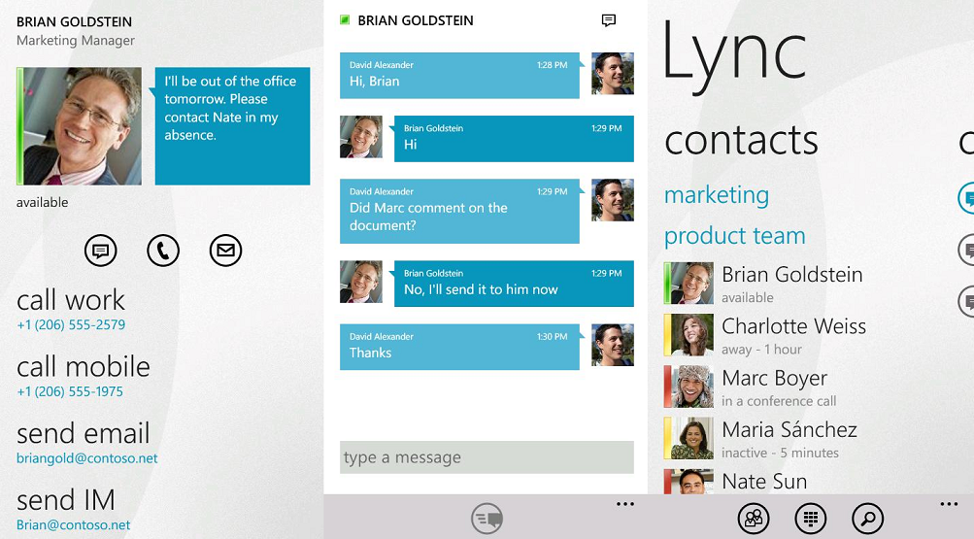
Communication
Skype:
for small group conversation;
share screen, group video chat (premium).
Lync:
for big groups (webinars);
easy recording, powerful interaction features.
Live Meeting:
for webinars.

Slide 23
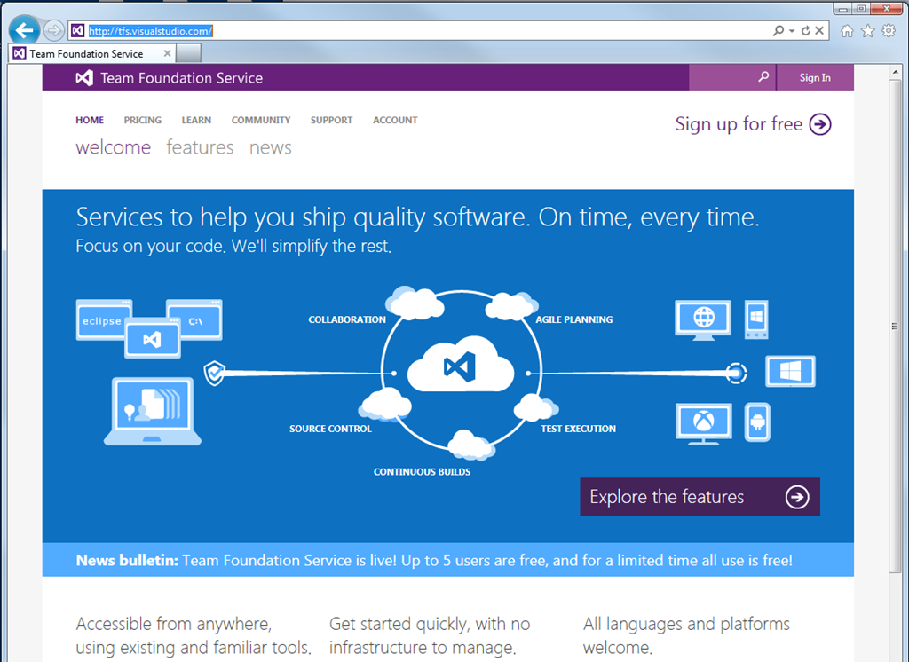
Source control
TFS Online:
cloud solution;
free for small groups;
natively integrated with Visual Studio.
Alternatives:
Codeplex.com;
Bitbucket.com;
Github.com.

Slide 24
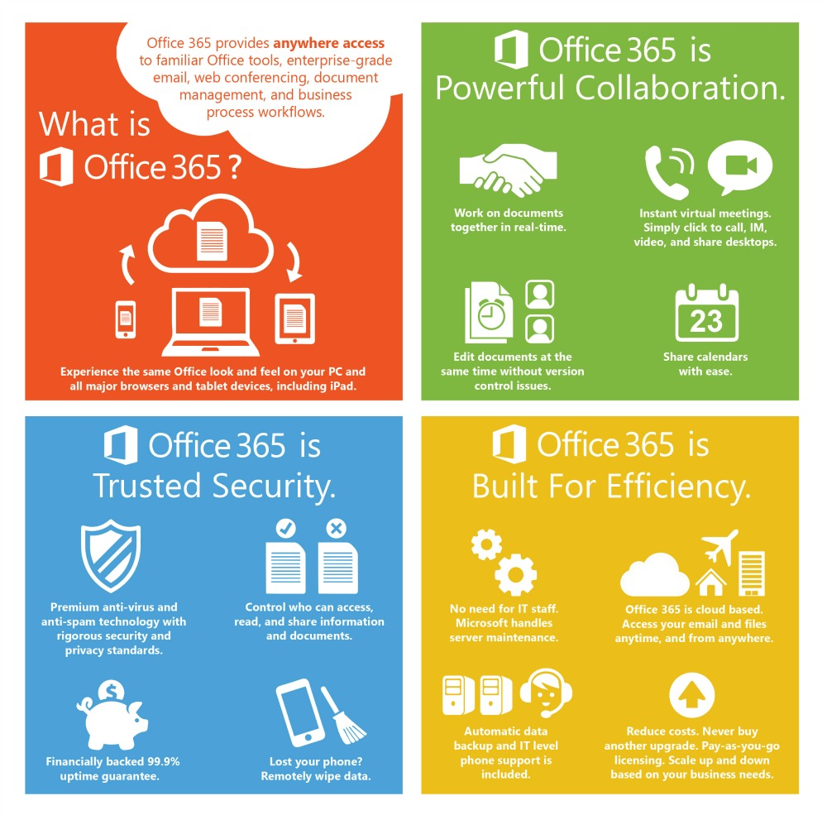
Other tools
OneDrive & Dropbox For files storage
Google Docs & Office 365 & DocuSign For docs management
Asana For task management
Bitrix 24 CRM

Slide 25
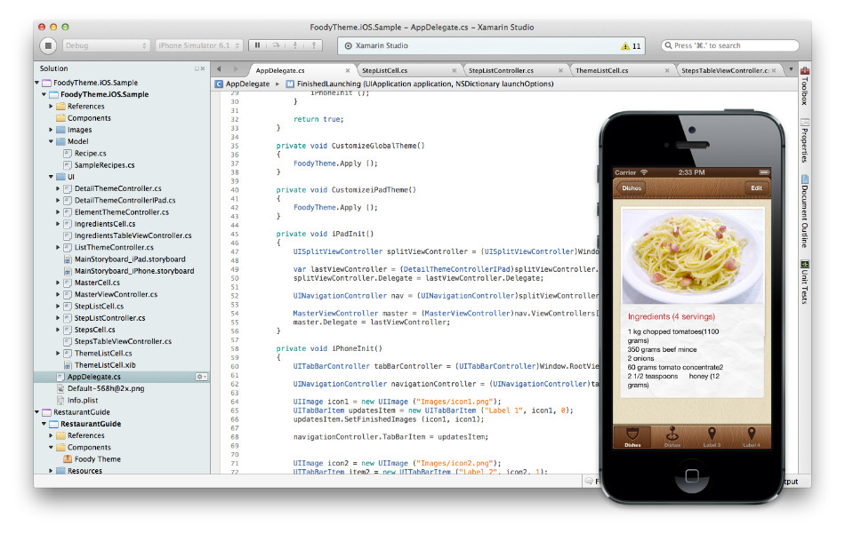
3rd party tools and services
Telerik Controls & tools
Syncfusion Metro studio for icons
Xamarin For cross platform development
RedGate SQL Server, .NET, Oracle tools
Pluralsight Hardcore Dev and IT Training

Slide 26
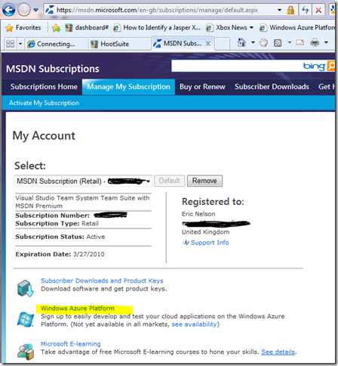
How to start
Buy MSDN, Office 365 subscriptions or become a Microsoft partner For any size of companies
Become BizSpark member For startups not older than 3 years
Get DreamSpark or MSDN AA subscription If you are a scholar, student, PhD or teacher
Nokia Developer Program Windows Phone Dev Center subscription, BugSense Performance Monitoring Solution, Telerik Rad Controls, remote app testing tools

Slide 27
Q&A
Alex.Krakovetskiy@devrain.com
@msugvnua

